Slide 1

Code Style & Quality 101
Computational Thinking and Programming with Python
Hieke Keuning
April 2023
Notes:
Icon created by LAFS from the Noun project

Slide 2


About me: Hieke Keuning
Assistant professor @ Dept. Information and Computing Sciences
Education: Part-time PhD, MSc Computer Science
Teaching: Modelling & Systems development, software project
Programming languages: Java, C#, Haskell, some PHP and JavaScript, Python
https://www.uu.nl/medewerkers/HWKeuning

Slide 3
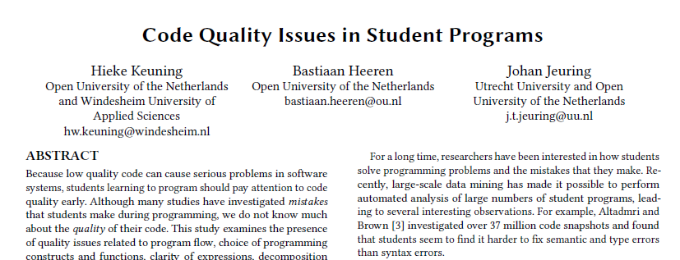
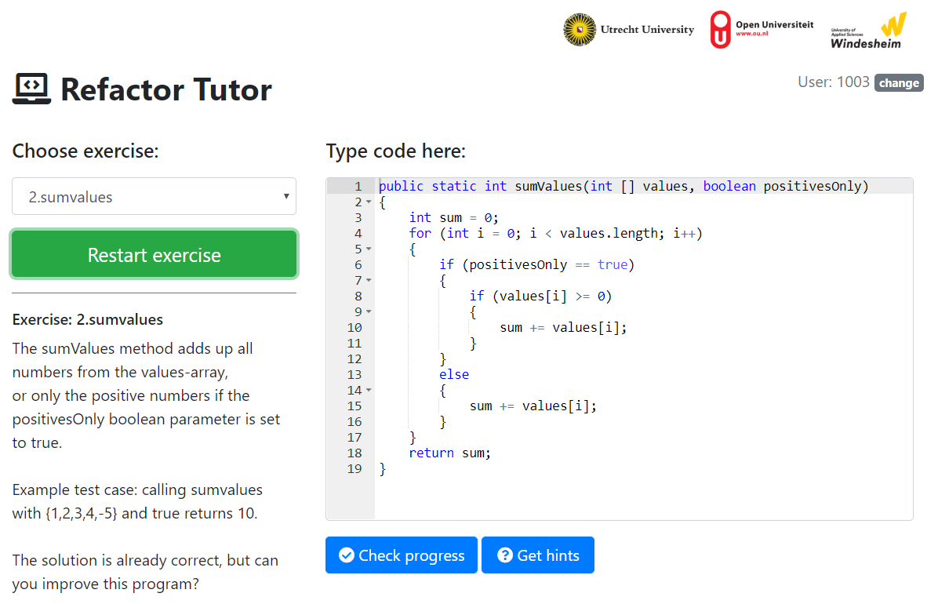
My research
Group: Software Technology for Learning and Teaching
Topics: Computer Science Education. Tutoring systems and automated feedback generation for learning programming. Student code quality. AI tools in education.

Slide 4
Code Style & Quality 101
What is it?
Tools & support
Why is it important?
Code smells & refactoring

Slide 5
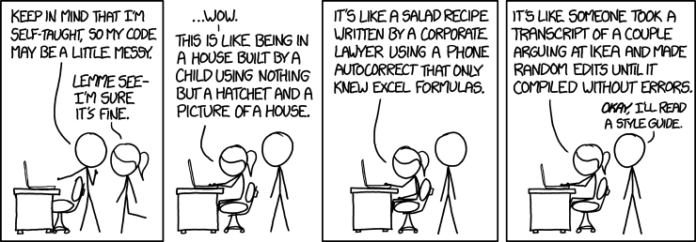
www.wooclap.com/OKNEMG
What is code quality?
Notes:
Xkcd 1513 Code quality

Slide 6
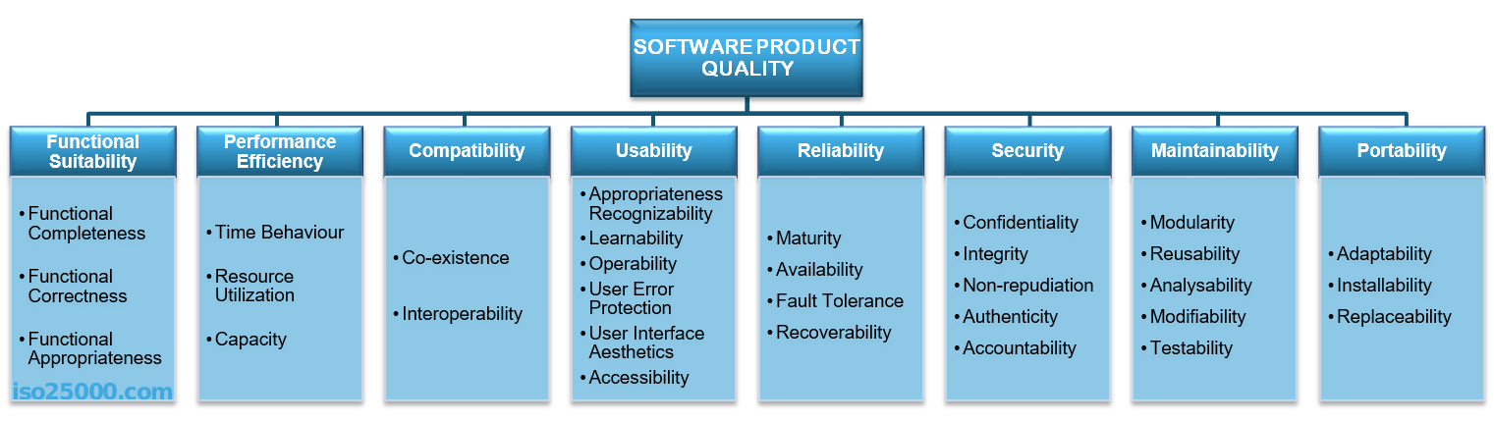
Software quality ISO/IEC 25010
https://iso25000.com/index.php/en/iso-25000-standards/iso-25010

Slide 7
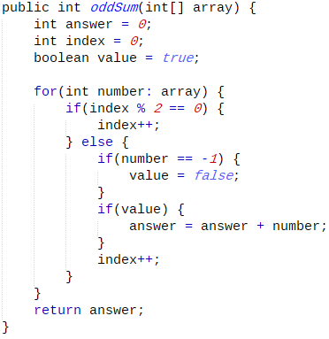


Students writing code
Functionally correct
However: unreadable, inefficient, too complex
⇨ low code quality
⇨ low maintainability of software systems

Slide 8
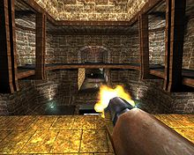
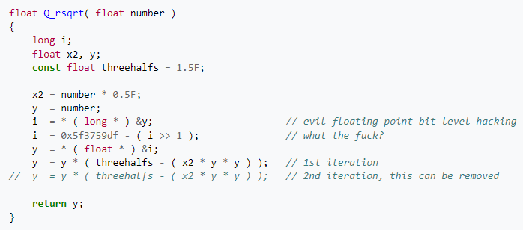
Quake III source code
https://en.wikipedia.org/wiki/Fast_inverse_square_root

Slide 9
Code quality
Properties of code that we can directly observe.
These properties are static, as opposed
to dynamic properties such as correctness, test coverage, and running time.
Categories: documentation, layout, naming,
flow, expressions, idiom, decomposition, and modularization.

Slide 10
Question
Do you pay attention to the quality of your code?
www.wooclap.com/OKNEMG

Slide 11

Why is it important?
Readability, naming & comments

Slide 12
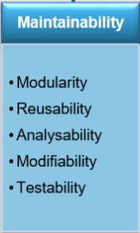
Why is it important?
Low code quality → decreased maintainability
Introduction of bugs
Much more time needed for adding new features
Higher costs
…

Slide 13
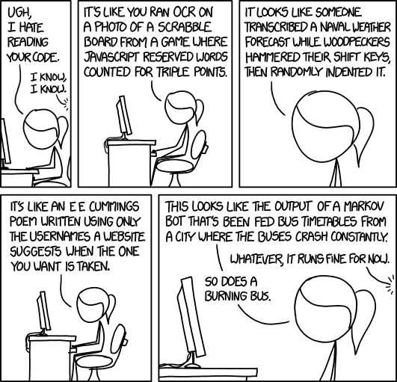
Why is it important to you?
Maintaining/extending your own code.
Reading and understanding other people’s code.
Notes:
Xkcd 1695 Code quality 2

Slide 14
Reading code
“Thus, programs must be written for people to read, and only incidentally for machines to execute.” (Abelson, Sussman & Sussman, 1985)
Developers spend 58% on reading code, compared to writing (Xia et al., 2017)
H. Abelson, G. J. Sussman, and J. Sussman, Structure and interpretation of computer programs. MIT Press, 1985.
Xia, X., Bao, L., Lo, D., Xing, Z., Hassan, A. E., & Li, S. (2017). Measuring program comprehension: A large-scale field study with professionals. IEEE Transactions on Software Engineering, 44(10), 951-976.

Slide 15

Reading code is hard
Limited size/duration short term memory
Experts are better than beginners
Also: Readability of code can be very personal, and programming language characteristics play a role
Solution: chunking
Hermans, Felienne. The Programmer's Brain: What every programmer needs to know about cognition. Simon and Schuster, 2021.
Notes:
P18

Slide 16

Chunking experiment
by ⎛ ⎛;
abk mrti gbar
cat loves cake
Exercise based on: The Programmer's Brain: What every programmer needs to know about cognition.
Notes:
5sec

Slide 17

What helps with chunking code?
Design patterns¹
Comments
Beacons: meaningful variable names, larger code structures with semantic meaning.
⇨ Form chunks
¹Vokáč, M., et al. (2004). A controlled experiment comparing the maintainability of programs designed with and without design patterns—a replication in a real programming environment. Empirical Software Engineering.
Notes:
http://dx.doi.org/10.1023/B:EMSE.0000027778.69251.1f

Slide 18
Identifier naming
Names take up a big portion of code
A form of documentation
Helps with readability
Correlation between bad names and bugs
foo = 42
bar = ‘hello’
Followed by baz, qux, quux, corge, grault, garply, waldo, fred, plugh, xyzzy, thud. In Dutch: aap, noot, mies
Notes:
Ch 8 PB
Foo: http://www.catb.org/jargon/html/M/metasyntactic-variable.html

Slide 19
Knowledge types in identifier names
Domain knowledge
Programming concepts
Conventions
customer
product
size
list
dictionary
sort
i, j
n
Notes:
P135 The programmer’s brain

Slide 20



Naming styles
b (single)
B (single)
lowercase
lower_case_with_underscores (snake case )
UPPERCASE
UPPER_CASE_WITH_UNDERSCORES
CapitalizedWords (camel case )
mixedCase
Capitalized_Words_With_Underscores ( )
Notes:
https://peps.python.org/pep-0008/#naming-conventions

Slide 21
How to choose a good name?
Combine dictionary words
Use name molds: patterns to combine elements (max_benefit_per_month, max_num_of_benefit, monthly_benefit_limit, ..)
Python: use snake_case (or CamelCase)
Be consistent!
Be careful with short/single identifiers

Slide 22
Exercise: sort the names according to preference
We need a variable to store the maximal benefits someone can receive per month.
Notes:
P142, Feitelson study

Slide 23

Too long?
InternalFrameInternalFrameTitlePaneInternalFrameTitlePaneMaximizeButtonWindowNotFocusedState (Java)
IDataGridColumnStyleEditingNotificationService (C#)
long/many syllables is harder to remember
may indicate an overload of responsibilities
Notes:
https://www.pushing-pixels.org/2007/11/07/and-the-longest-jre-class-name-is.html

Slide 24
Comments or self-documenting?
Comments should raise the level of abstraction, describing what a logical block of code does.
High-level comments help with chunking
# this function calculates the second largest
# value in a list of integers
Or?
second_largest_value(list: int)
Notes:
P28 ProgrammersBrain

Slide 25
Comments should not repeat the obvious
Explain why the code is written the way it is, rather than simply repeating what it does.
i+=1 # increment i by one
age = 20 # this variable stores your age
# greet the people of Utrecht
print("Hello Utrecht!")

Slide 26
Comments may reveal problems
# don’t remove this line!!!
# TODO: make this code faster

Slide 27
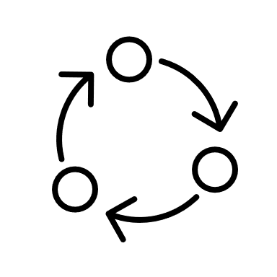
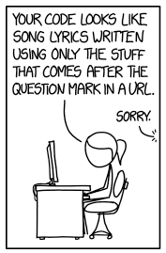
Code smells, metrics & refactoring
Notes:
Part of https://xkcd.com/1833/ Code Quality 3

Slide 28
Exercise: can you improve this code?
https://www.online-python.com/MwO1l4hKdo
a
def is_expensive(price): if price > 100: return True else: return False
c
target = 1000 start = 25 years = 0 reached_target = False while not reached_target: if start >= target: reached_target = True else:
start = start + (start * 0.01) years += 1 print(years)
if is_expensive(1000) == True: get_loan() else: if not is_expensive(1000): print('cheap')
b
Notes:
https://github.com/hiekekeuning/code-quality-examples/tree/main/bad-examples

Slide 29
def is_expensive(price): if price > 100: return True else: return False
def is_expensive(price): return price > 100
if is_expensive(1000) == True: get_loan() else: if is_expensive(1000) == False: print('cheap')
if is_expensive(1000): get_loan() else: print('cheap')
target = 1000 start = 25 years = 0 reached_target = False while not reached_target: if start >= target: reached_target = True else:
start = start + (start * 0.01) years += 1 print(years)
target = 1000 start = 25 years = 0 while start < target: start += start * 0.01 years += 1 print(years)
Notes:
Also: start variable could have a better name, and a constant variable can be used for 0.01 (INTEREST = 0.01)

Slide 30
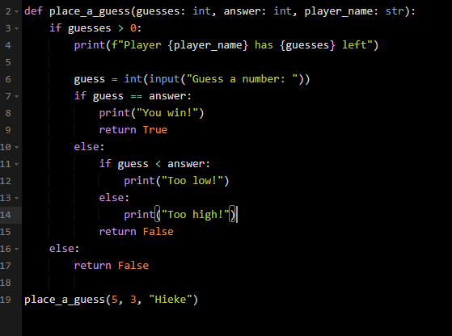
Exercise: Can we improve this code?
https://www.online-python.com/UocPkI1CmL
Notes:
From: https://www.youtube.com/watch?v=Brw9p4syhIg

Slide 31
Improved!
def place_a_guess(guesses, answer, player_name): if guesses <= 0: return False print(f"Player {player_name} has {guesses} guesses left") guess = int(input("Guess a number")) if guess == answer: print("You win!") elif guess < answer: print("Too low!") else: print("Too high!") return guess == answer
Handle special cases first
Simplify logic

Slide 32
How to identify problems in code?
Quantitative:
code metrics
Qualitative:
code smells

Slide 33
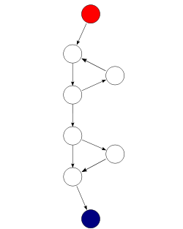



Code Metrics
Quantitative measurements of code complexity.
Examples:
Cyclomatic complexity (nr of paths through code)
ABC score ( (weighted sum of) nr of Assignments, Branches and Conditionals in code)
Lines of Code
Scores above a certain threshold may point to problems
$$CC=E −N+2P$$
$$=9 −8+2∗1$$
$$=3$$
Notes:
SaaS 9.5

Slide 34
Code complexity ⎯ Guidelines
at most 4 branch points per method:
if, &&, ||, while, for,..
Avoid deep nesting:
if c1:
if c2:
if c3:
for …:
Notes:
SIG guideline: Write simple units of code (Ch3)

Slide 35

Code smells
Code constructs that are functionally correct, however, they might indicate bad code design, affecting software quality attributes.
Examples: code duplication, dead code, overly complex code, and code with low cohesion and high coupling.

Slide 36

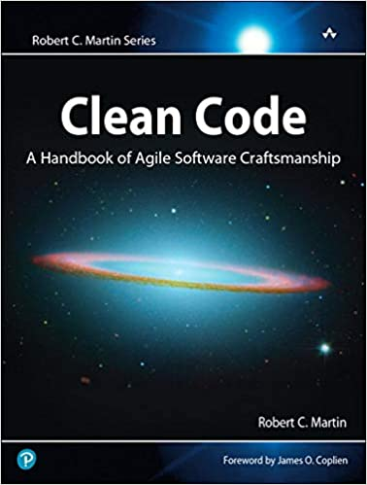
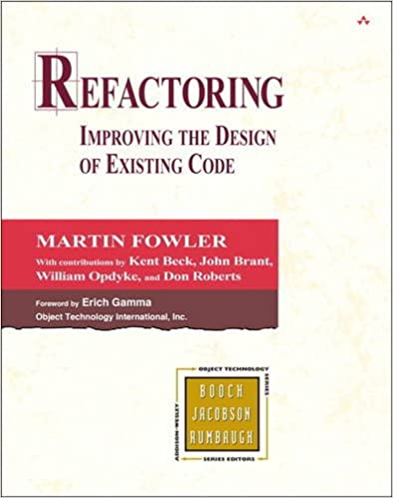
Refactoring
What Changing inner structure while maintaining external behaviour.
Why Reduces cognitive load, increasing readability.
How Stepwise, running unit tests at each step

Slide 37
Code duplication
Use the same code multiple times
Introduce a method
temp_f1 = 100 temp_f2 = 25 temp_f3 = 34 temp_c1 = (5/9)*(temp_f1-32) temp_c2 = (5/9)*(temp_f2-32) temp_c3 = (5/9)*(temp_f3-32) avg_temp_c = (temp_c1 + temp_c2 + temp_c3) / 3
def fahrenheit_to_celsius(temp): return (5 / 9) * (temp - 32) temp_c1 = fahrenheit_to_celsius(temp_f1) temp_c2 = fahrenheit_to_celsius(temp_f2) temp_c3 = fahrenheit_to_celsius(temp_f3) avg_temp_c = (temp_c1 + temp_c2 + temp_c3) / 3
Or use a list and map…
temps_f = [100, 25, 34] temps_c = list(map(fahrenheit_to_celsius, temps_f)) avg_temp_c = sum(temps_c) / len(temps_c)
Notes:
From SOM course
https://refactoring.com/catalog/extractFunction.html

Slide 38
Magic numbers
Use numbers directly in source code
Introduce a constant variable
subtotal = 100 total = subtotal + 9.95 price = total + (total * 0.10) print(price)
SHIPPING_FEE = 9.95
SALES_TAX = 0.10
total = subtotal + SHIPPING_FEE
price = total + (total * SALES_TAX)
print(price)
Notes:
https://refactoring.com/catalog/replaceMagicLiteral.html

Slide 39
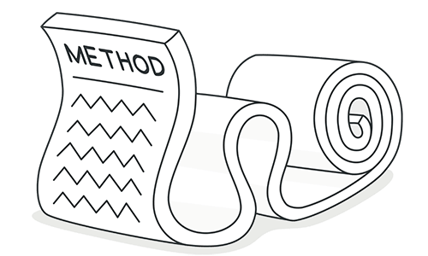
Long method
Guideline: > 15 lines
Possibly with vague name.
Usually indicates a method is doing too much: weak cohesion
Split into smaller, more cohesive methods
SOLID principle 1:
Single responsibility – every class should be responsible for one thing only (strong cohesion)
def doIt(): #... # 500 lines of weakly cohesive gibberish #...
print(“the end”)
Notes:
SIG Maintainability guidelines: Write short units of code (Ch2)
https://refactoring.com/catalog/extractFunction.html

Slide 40
Exercise: Can we improve this code?
def ask_name_and_age_and_check_age(): while True: name = input("Enter your name: ") if len(name) <= 1: print("Names have more than one character! Try again") else: break while True: line = input("Enter your age: ") try: age = int(line) break except ValueError: print("That's not a number! Try again") YOUNG_CUTOFF = 30 if age <= YOUNG_CUTOFF: print(f"{name}, you are young!") else: print(f"{name}, you are old!")
Notes:
We can divide this code into three methods: ask_name(), ask_age() and check_age()

Slide 41

Tools, sources & summary

Slide 42
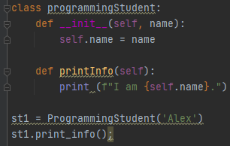
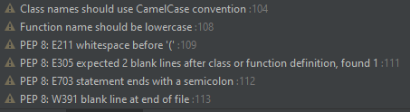
Style guides & tools
Python Style (PEP8): https://peps.python.org/pep-0008/

Slide 43

Tools
Pylint: https://pylint.readthedocs.io/en/latest/
Student friendly: pyTA (https://github.com/pyta-uoft/pyta)
Checks often integrated in code editors.

Slide 44


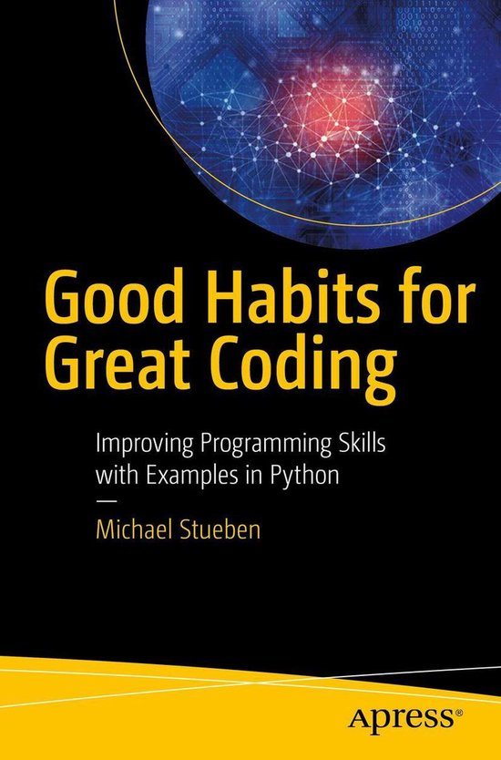
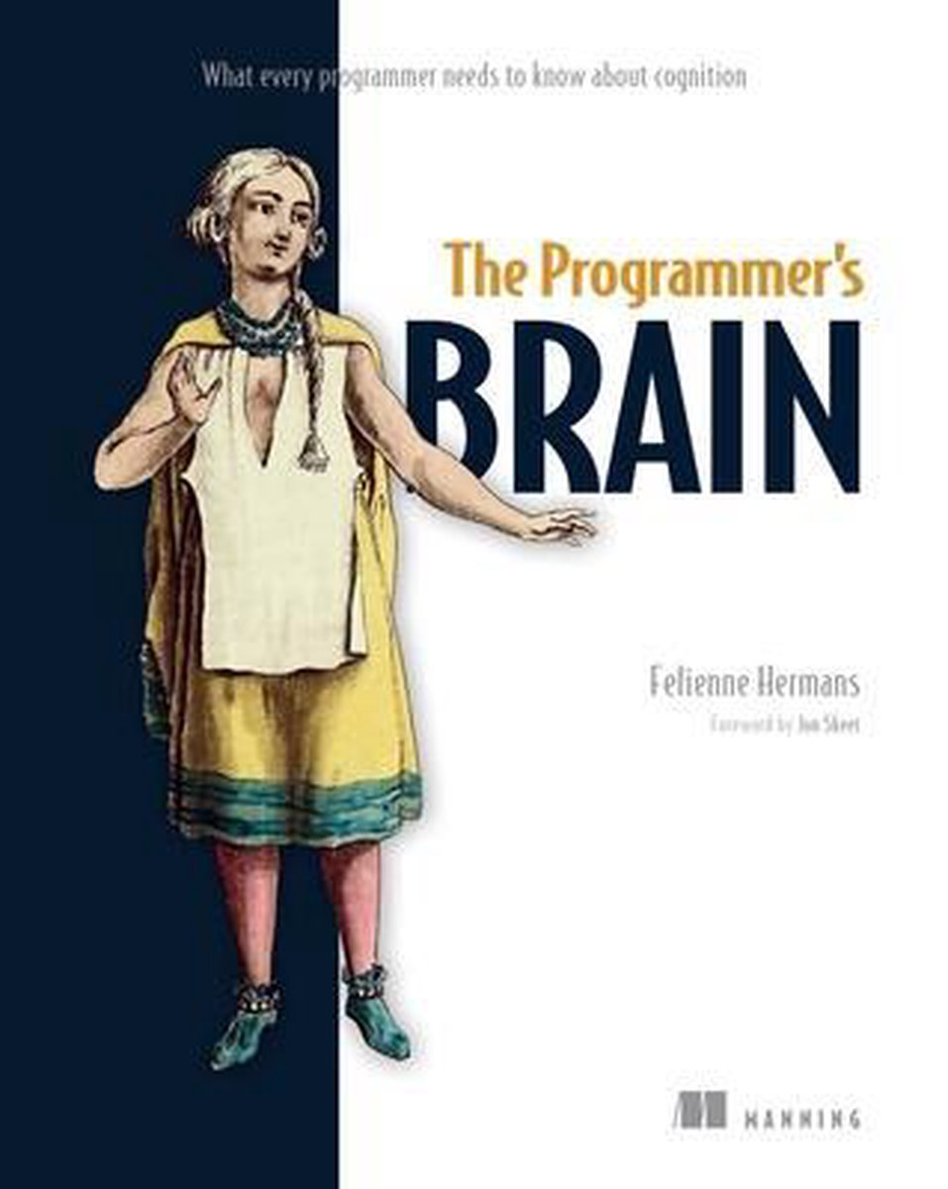
Want to learn more?
Course: INFOB2SOM Systeemontwikkelingsmethoden: learn more about OO design, refactoring, design patterns.
YouTube: ArjanCodes https://www.youtube.com/c/arjancodes
Book: The programmer’s brain, Felienne Hermans
Book: Good Habits for Great Coding: Improving Programming Skills with examples in python
Web: https://realpython.com/learning-paths/writing-pythonic-code/

Slide 45

Takeaway
Detect code smells
Refactor to improve code
Use tools and style guides
Always consider the readability of your code
Feedback on Wooclap is appreciated!
h.w.keuning@uu.nl

